Slide 1



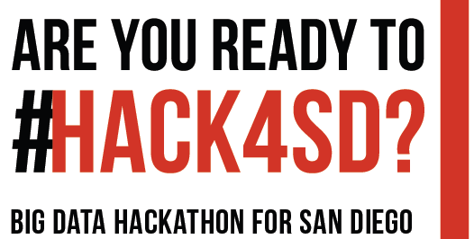

2019
Please Tweet about this event with #HACK4SD

Slide 2


Opening Remarks and Orientation
Co-organizers
Dr. Amy Schmitz Weiss (Journalism and Media Studies)
Dr. Ming Tsou (HDMA Center, Geography)
Dr. Atsushi Nara (HDMA Center, Geography)
Platinum Sponsor: Zip Launchpad SDSU

Slide 3
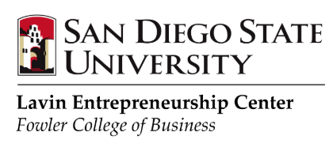
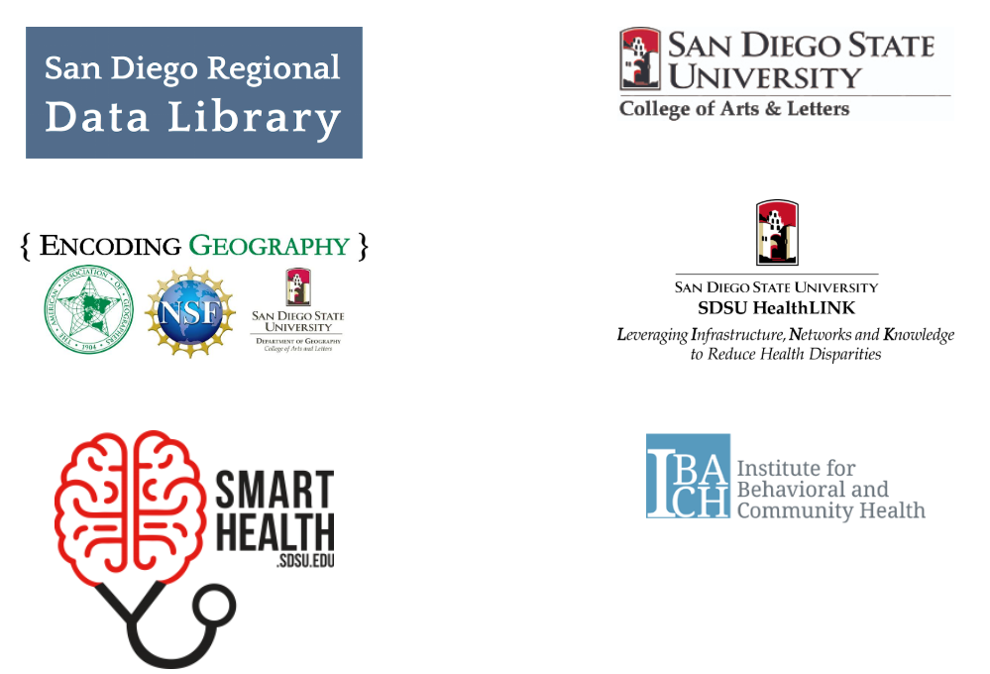



Gold Sponsors
Silver Sponsors

Slide 4


Bronze Sponsors

Slide 5
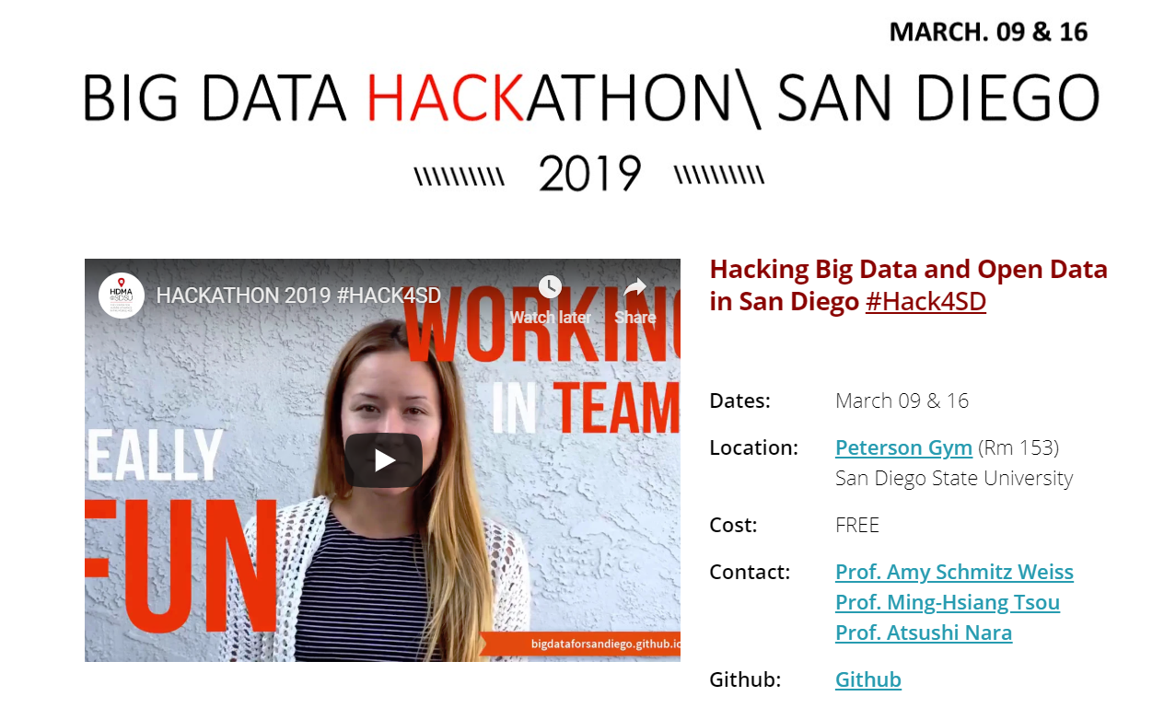
YouTube Video:
https://www.youtube.com/watch?time_continue=2&v=SuuuXn9B9tw

Slide 6
What is Big Data?
Big Data is a large dynamic dataset created by or derived from human activities, communications, movements, and behaviours. (Tsou, 2015).
3V: Big Volumes, High Velocity, and High Variety
The term, Big Data, refers to big ideas, big impacts, and big changes for our society in addition to a big volume of datasets.
Tsou, M. H. (2015). Research challenges and opportunities in mapping social media and Big Data. Cartography and Geographic Information Science, 42:sup1, 70-74. doi: 10.1080/15230406.2015.1059251. http://www.tandfonline.com/doi/full/10.1080/15230406.2015.1059251#.VeCVyPlVhBd

Slide 7
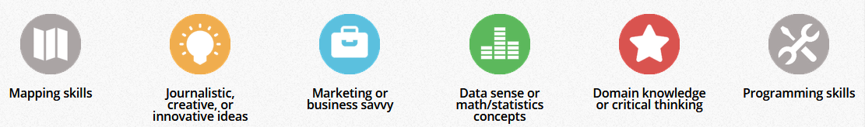
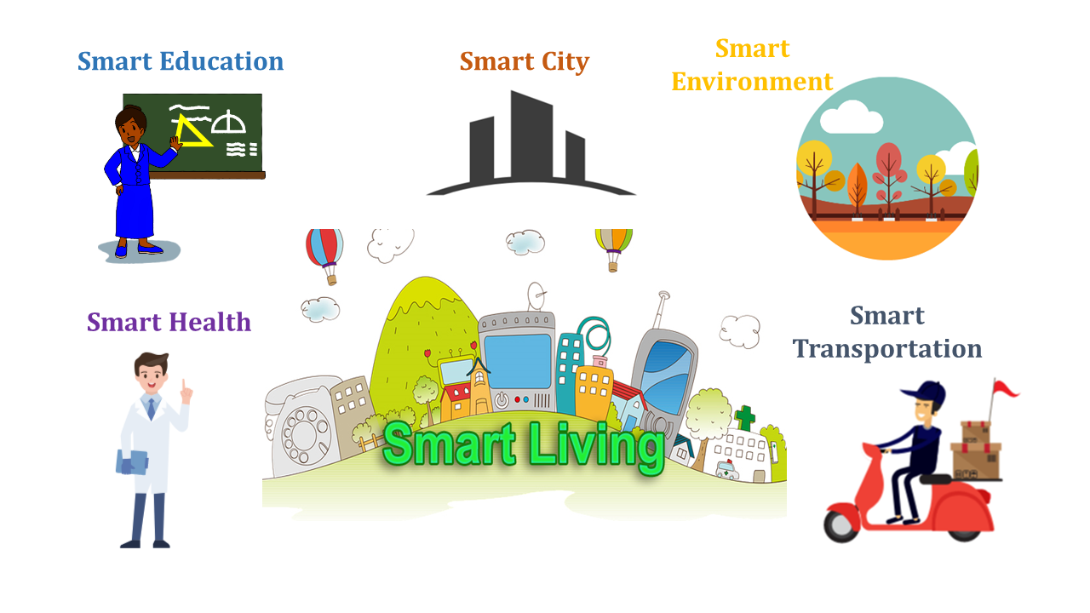
Hackathon is a team work effort!
The 2019 Big Data Hackathon for San Diego will promote Data Science and Big Data Analytics for both students and educators and demonstrate technological applications for SMART LIVING

Slide 8
Hackathon Questions (Examples):
SMART CITY:
1. How can San Diegans have better options for parking in high-traffic areas to avoid congestion?
2. How can we get an emergency vehicle to the scene in shortest possible time can save lives?
SMART Environment:
1. How can San Diegans have access to better air quality indoors and outdoors? 2. How can we clean San Diego beaches effectively?
SMART Education:
1. How can schools better utilize their physical resources? 2. How to provide better school bus routing plan for San Diego Unified School Districts?
SMART Transportation:
1. How can San Diegans make better transportation decisions of getting from point A to Z that leaves a smaller carbon footprint?
SMART Health:
1. How can we share useful public health information and web analytical tools for improve public health in San Diego? 2. What chronic diseases affect San Diegans and how can these conditions be managed daily?

Slide 9
Participant Agreement
The Intellectual Property of Codes and Apps created within this Hackathon will be Open Source and Accessible for San Diego Community.
All outputs and codes should be saved in the San Diego Big Data Hackathon Github Repositories, which are Open Source with Creative Commons Licenses. There is enormous value to the San Diego community by having an open repository of these outputs and codes.
The hackathon is open to all individuals at least 13 years of age at the time of entry.
To participate, you must be able to attend the Hackathon in person in San Diego (no remote participation).
Other items (See the actual Participant Agreement Form).
Please Sign it and Return to our Hackathon Organizers / Volunteers (Who wear the White Hackathon T-shirt).

Slide 10
Team Formation Procedure
11:00 – 12:00: Team Formation and Group meeting/Discussion
Individuals should meet your group members now
Discuss the possible Hackathon topics
Each team will select one team coordinator
Each team coordinator should have or create a Github account
http://bigdataforsandiego.github.io/data/BigDataForSanDiego_Github.pdf
12:00 – 13:00: Lunch and Team Finalized (Pizza)
Each team coordinator will submit the team information
via Google Form by 12:30 pm!
Link: https://goo.gl/forms/PHLwFsKl1vJoduOh1
(This link is also available on the Hackathon site under agenda)
We will assign a Github repository for each team

Slide 11
YOUR INNOVATION CAN WIN PRIZES
Best Overall Projects:
1st Prize: $600
2nd Prize: $300
3rd Prize: $150
Most innovative idea: $100
Strongest teamwork: $100
Additional $2500 In Prizes!!!

Slide 12
Additional Prizes for SDSU Students
Sponsored by Zip Launch Pad (team must have at least one active SDSU student. Winning team must apply to the ZIP Launchpad through our application cycle and be admitted by the Selection Committee to receive 2nd $500 award).
Best Overall $500
Women in STEM - Best Startup Idea $500
VETERAN- Best Startup Idea $500
Best Startup Idea - Aging Independently $500
Additional Prizes for K-14 Students
Sponsored by Encoding Geography (NSF project).
Young Geo-computational Thinker $500 (All members of the team must be second-year college students or younger. The team must apply geographical and computational thinking (geo-computational) skills to their solution)

Slide 13
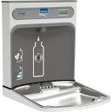
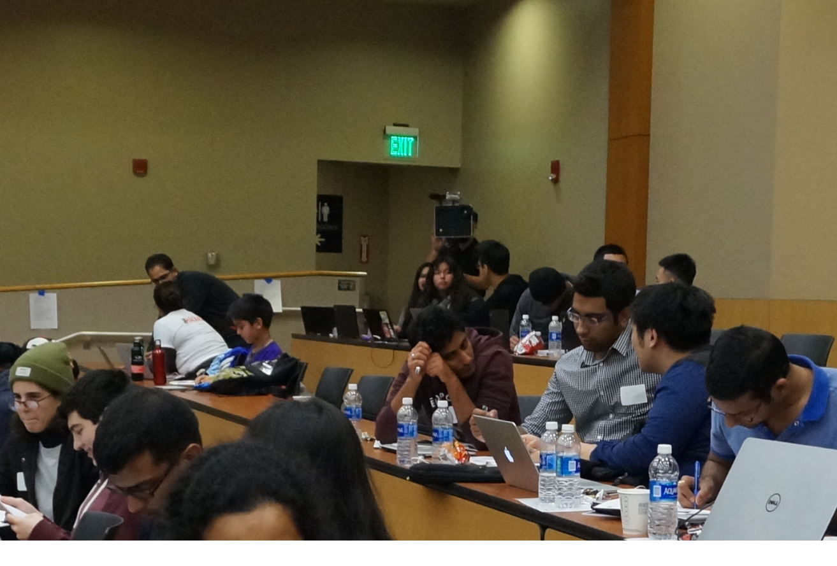
Food and Drinks:
Use Your Own Water Bottle: Please Mark your name and Refill it on the refill station.
No food (Pizza) INSIDE the Classroom.
Please consume food at the Hallway or Outside the building. Thank you.
Two Coffee Breaks (morning and afternoon).
Lunch (12pm) : Pizza and Granola Bars, Chips.
RESTROOM: On the Left Side of the Classroom. DO NOT close/lock the entrance door.

Slide 14



Watch Your Belongings
We are not responsible for your personal items left in the classroom. Please don’t leave your important devices unattended.

Slide 15
Free SDSU Guest Wi-Fi Access
1. Make sure the Internet Browser and all of the tabs or windows are closed.
2. Locate your WiFi menu/access.
3. Select SDSU_Wireless
4. Open your Internet browser. “Welcome to SDSU“ should appear.
5. Click on Guests.
6. Enter in your Full Name.
7. Enter in your Cell Phone number.
8. Select your Mobile Carrier from the list. You will not be able to connect to the university’s network, if your Cellular Service Provider is not in the Mobile Carrier list, your cellular service or phone does not accept SMS text messages or you do not have a cellular phone.
9. Enter your Email Address. This will become your username to log into the network
10. Read and Accept the SDSU terms of use
11. Click Register.
12. Check you cell phone for a text message from wifi-registration@sdsu.edu. In the text message you will find the username and password to enter into SDSU_Wireless web page.

Slide 16
Tools http://bigdataforsandiego.github.io/#tools
(Software Development Tools, Presentation, Hosting, File Sharing, Could Data Storage, Project Management)
Free Amazon EC2 Account Credits ($100): For each team who would like to request credits for the hackathon, email to mtsou@sdsu.edu (this may need you to set up with credit card info).
(Or you can use your SDSU email to set up AWS Educate Account without using credit card.) Go to GitHub site → search for “Tableau-and-Amazon-EC2-tutorial”.

Slide 17
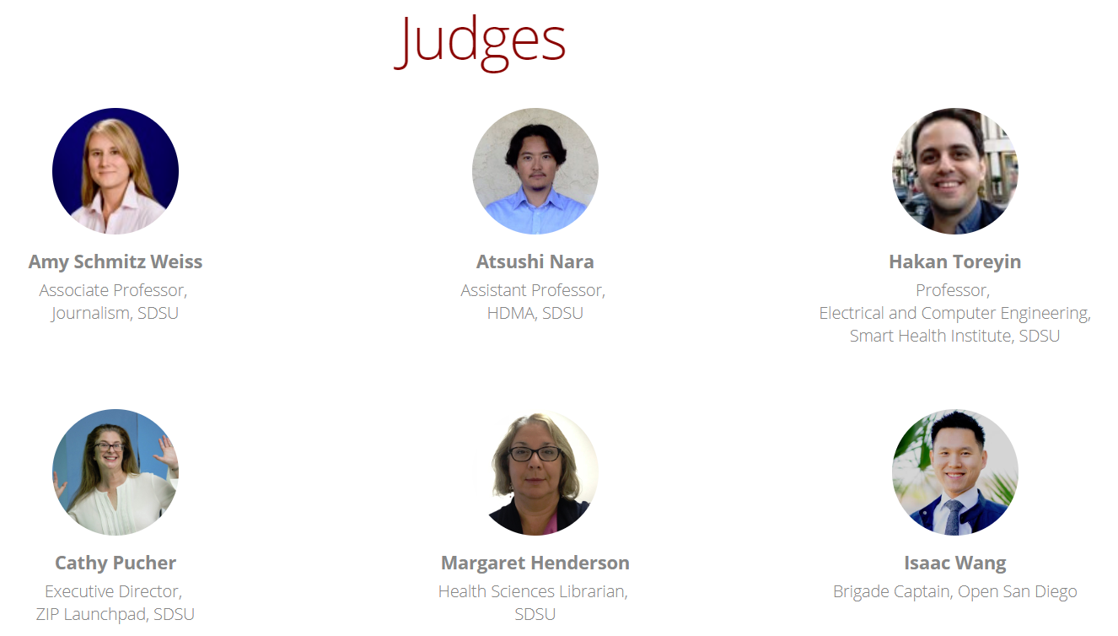
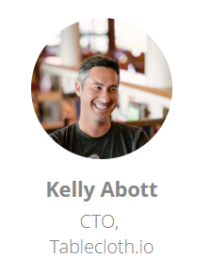
Thank to our Judge Panel

Slide 18
Thank to our Mentors
Dr. Ming-Hsiang (Ming) Tsou (Geography, SDSU), Professor)
Erik Caldwell (City of San Diego), Deputy Chief Operating Officer
Dr. Karen Haines (Digital signal/image/video processing).
Dr. Bruce Appleyard (City Planning & Public Administration, SDSU).
Elise Telford (Digital Marketing Strategist at Futurety).
Eric Busboom (Executive Director, San Diego Regional Data Library).
Ashley Graham (the founder and creative director of Brandesso).
Nawar Khabbaz (Data Engineer, Sotera Wireless Inc.).
Gurinder Singh (Software Engineering Manager, SmartDrive).

Slide 19
How to submit project proposal in Github ? https://github.com/BigDataForSanDiego

Slide 20
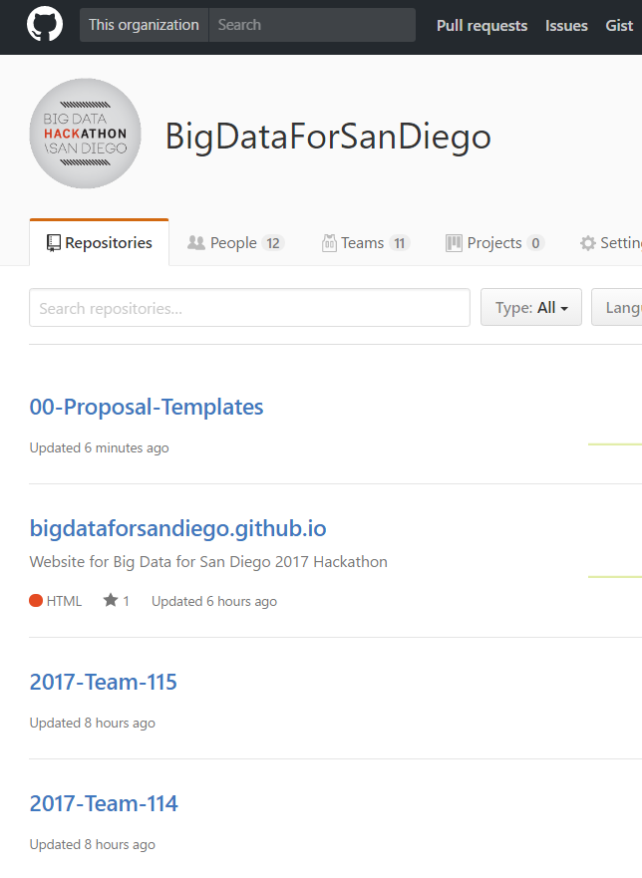
Each Team has a unique Team-ID (101 – 121, 201-222, 301 – 313)
Each Team needs to select a TEAM coordinator who has a Github Account (or create a new one).
Tell Jaehee your team-ID and the coordinator’s Github Account. She will add the account as Admin for your Team Github Repository by 1:00pm.
Each Team will publish their proposals, slides, and codes on their own Team-ID repository.

Slide 21
Proposal Submission Guidelines
3/09 (First Day of Hackathon)
By 4:30 p.m. you must submit your proposal to your GitHub team repository.
Download the proposal submission template from GitHub (github.com/BigDataForSanDiego) and complete the following:
The official team name, number, team member names, team leader
The public health question you are answering from the main list (or one that you have made on your own)
The team’s hackathon idea
The dataset(s) you might use
From 4:30-5:30 p.m. we will ask all teams to make a 90 second presentation
Select a speaker for your group and be ready to talk within 90 seconds.
stating your team name, the question you are seeking to answer, the hackathon idea and the dataset(s) you might use.

Slide 22
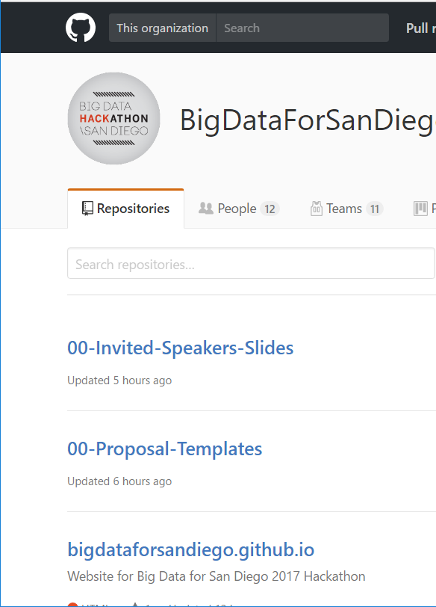
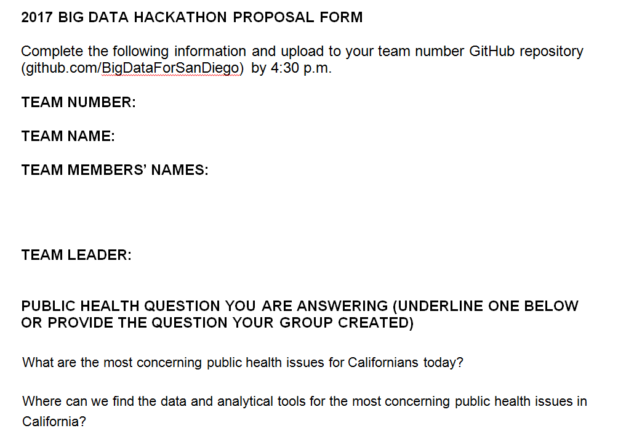
Proposal submission template
( 2019 BIG DATA HACKATHON PROPOSAL FORM.doc download from Github)

Slide 23
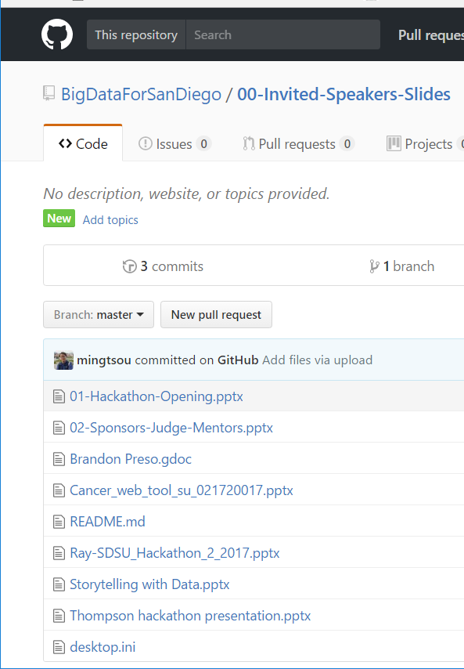
This opening slides and speaker’s slides are available in the Github to download.

Slide 24
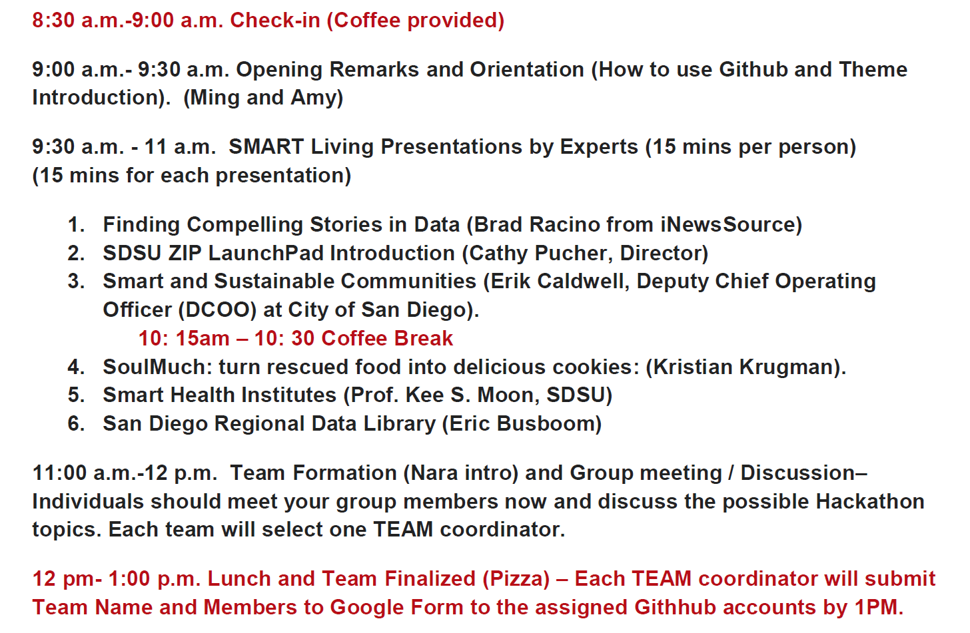
Agenda (Morning)

Slide 25
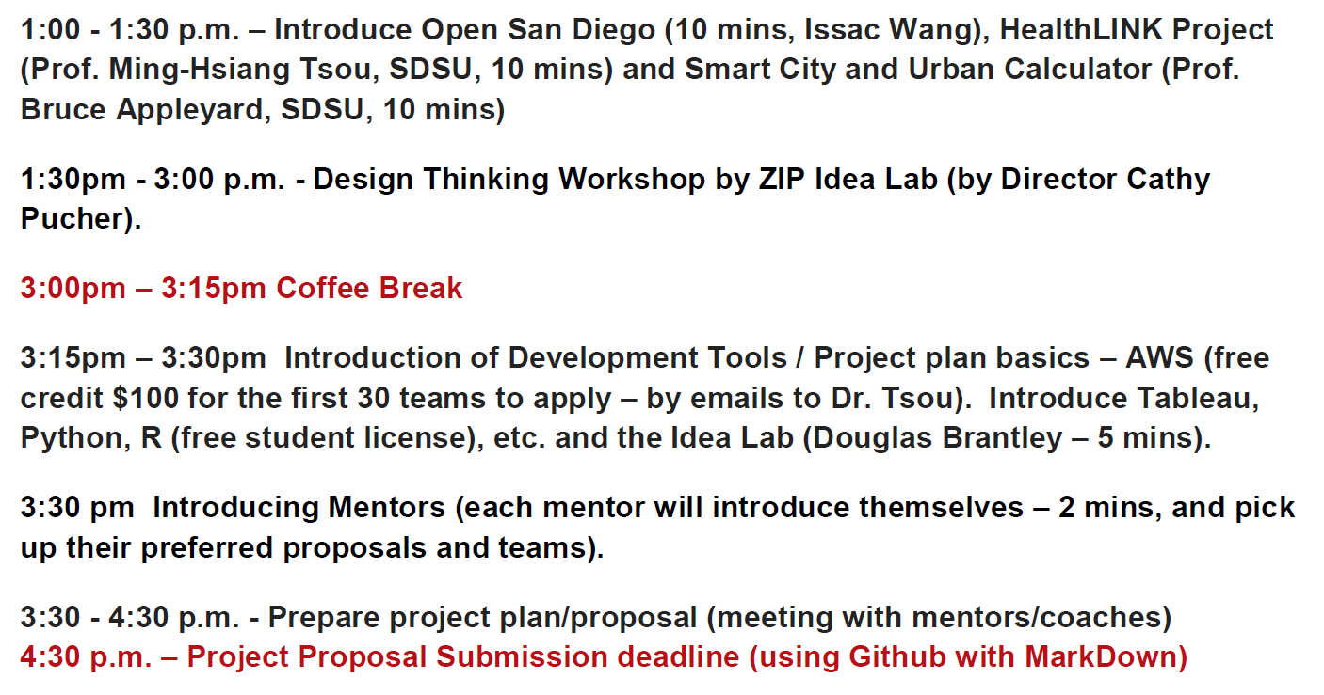
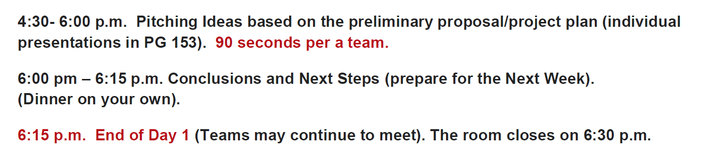
Agenda (Afternoon)

Slide 26
9:30 a.m. - 11 a.m. SMART Living Presentations by Experts (15 mins per person) (15 mins for each presentation)
Finding Compelling Stories in Data (Brad Racino from iNewsSource)
SDSU ZIP LaunchPad Introduction (Cathy Pucher, Director)
Smart and Sustainable Communities (Erik Caldwell, Deputy Chief Operating Officer (DCOO) at City of San Diego).
10: 15am – 10: 30 Coffee Break
SoulMuch: turn rescued food into delicious cookies: (Kristian Krugman).
Smart Health Institutes (Prof. Kee S. Moon, SDSU)
San Diego Regional Data Library (Eric Busboom)

